Slide 1
SESSION InITIATION PROTOCOL (sıp)
HISTORY INFO
Erdinç DAĞLI

Slide 2
SIP is found in the application layer, such as HTTPS. SIP starts, edits, and ends a session. It also manages conference calls. There are also specific tasks, such as adding or removing attendees to an existing session. A dialog is just a series of transactions between two SIP peers. The purpose of a dialog is to setup, possibly modify, and then teardown a session. Hence the name Session Initiation Protocol. A transaction consists of a Request, any non-final (1xx) Responses received, and a final Response (2xx, 3xx, 4xx, 5xx, or 6xx), as well as the acknowledgements of the Responses (ACK or PRACK), except for ACKs to 2xx Responses.
SESSION INITIATION PROTOCOL (SIP)
Notes:
SIP defination should be enhanced. Also, please explain DIALOG and TRANSSACTION and difference between them.
Okey.I added new defination for SIP in my words.and also explained DIALOG and TRNSACTION .

Slide 3
User agent (UA):That ıs general represantatıon of Clıent and server as noted below; User agent clıent (UAC):UAC sends a request and receıves a response user agent server (uas):UAS receıves a request and sends a response Proxy server Stateless Proxy server:It only receives and Forwards the message. Stateful Proxy Server: It keeps track of every request and response received and can use it in future if required.
SESSION INITIATION PROTOCOL (SIP)
Network Elements

Slide 4
INVITE : INVITE is used to initiate a session with a user agent. BYE : BYE is the method used to terminate an established session. cancel : CANCEL is used to terminate a session which is not established. ack : ACK is used to acknowledge the final responses to an INVITE method. optıons : OPTIONS method is used to query a user agent or a proxy server about its capabilities and discover its current availability. ınfo : INFO is used by a user agent to send call signalling information to another user agent with which it has established a media session. UPDATE : Modifies the state of a session. refer : Asks the recipient to issue call transfer. subscrıbe : Subscribes for Notification from the notifier. Nofıty : Notifies the subscriber of a new event.
SESSION INITIATION PROTOCOL (SIP)
Request Messages
Notes:
Should add UPDATE,REFER,SUBSCRIBE,and NOTIFY SIP requests.
I updated your advices.You may check?

Slide 5
1xx:provısıonal /ınformatıonal response: 100 Tryıng 180 rıngıng 181 call ıs beıng forwarded 183 SessIon PRogress 2xx:success response: 200 ok 202 accepted 3xx:Redırectıon response: 300 multıple choıces 301 moved permanently 302 moved temporarıly
SESSION INITIATION PROTOCOL (SIP)
Response Messages

Slide 6
4xx:clıent faılure response: 400 bad request 403 forbıdden 404 not found 5xx:server faılure response: 500 server ınternal error 502 bad gateway 6xx:global faılure response: 600 Busy everywhere 603 declıne
SESSION INITIATION PROTOCOL (SIP)
Response Messages

Slide 7
The fundamental functionality provided by the request history information is the ability to inform proxies and UAs involved in processing a request about the history or progress of that request (rfc 4244) The History-Info header is optional in that neither UAs nor Proxies are required to support it.(rfc 4244) Without the SIP History-Info Header the redirecting/orıgınal called number information would be lost.
SESSION INITIATION PROTOCOL (SIP)
History Info

Slide 8
The SIP History-Info header is generated by a User Agent or proxy and is passed from one entity to another through requests and responses. The SIP History-Info Header displays the following: -The URI or address that indicates the redirecting number -The reason for the Request-URI or address modification -Chronological ordering of the Request History information
SESSION INITIATION PROTOCOL (SIP)
History Info
Notes:
You think ? Is this part okey ? If you want to remove this one.i can remove.because i putted information previos part for SIP History Info. Is it enough ? Or not ?

Slide 9
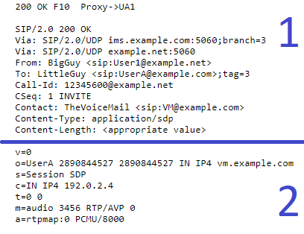
For f10 ınvıte, request urı : The Request URI is the contact information of the next hop in the call Route. VIA : The Via header field indicates the path taken by the request so far and helps in routing the responses back along the same path. From : The From header field indicates contact information of the initiator of the SIP INVITE request. To : The To header field contains the information about the called party or the recipient of the request call – ıd : The Call-ID header field is a unique ID identifying the SIP call. Hıstory-ınfo : The header that chronologically (rfc 4244) lists the INVITE and RESPONSEs made by SIP.
SESSION INITIATION PROTOCOL (SIP)
History Info
Notes:
Also i added this part.i thought i can show to expalin History Info and Sdp outputs’s shortcuts on the same part. For intelligibility.

Slide 10
The first part is a SIP output that sends a confirmation response in code 200. The next section gives us more information about the connection with SDP Headers. v=protocol versıon number o=username,ıd,network address.. S =Sessıon name C=connectıon ınformantıon t =tıme the sessıon ıs actıve m=medıa name and transport address (rfc 6157) a=zero or more sessıon attrıbute lınes
SESSION DESCRIPTION PROTOCOL (SDP)
Notes:
Replace 4244 with original reference of SDP. RFC-3264 is real reference for SDP but that has been obsoleted with a new one. Please find latest reference for SDP.
I replaced RFC 4244.I founded RFC 6157 but I’m not sure .May you check for me ?

Slide 11
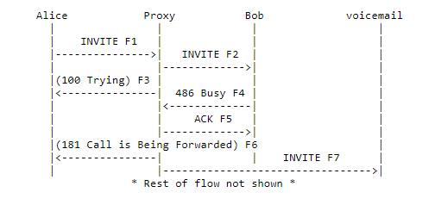
Alice calls Bob. Bob's proxy determines that Bob is busy, and the proxy forwards the call to Bob's voicemail. (rfc 4458)
SESSION INITIATION PROTOCOL (SIP)
History Info

Slide 12
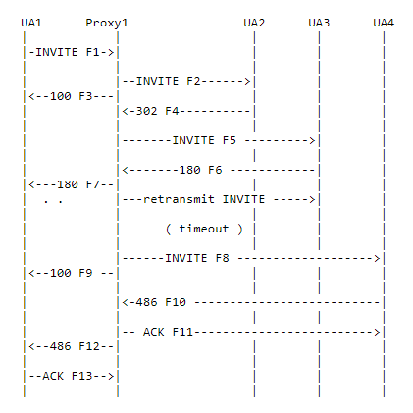
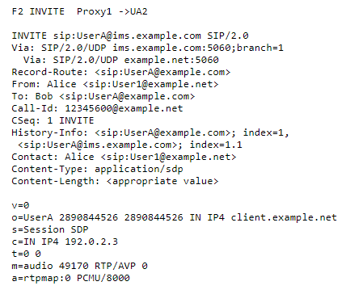
Sıp Detaıls and sdp detaıls for f2 Invıte (rfc 4244)
SESSION INITIATION PROTOCOL (SIP)
History Info

Slide 13
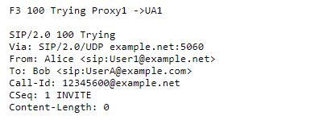
Sıp Detaıls and sdp detaıls for f3 Tryıng (rfc 4244)
SESSION INITIATION PROTOCOL (SIP)
History Info

Slide 14
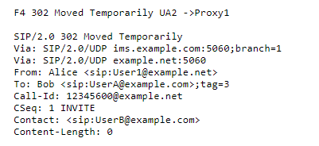
Sıp Detaıls and sdp detaıls for f4 moved temporarıly (rfc 4244)
SESSION INITIATION PROTOCOL (SIP)
History Info

Slide 15
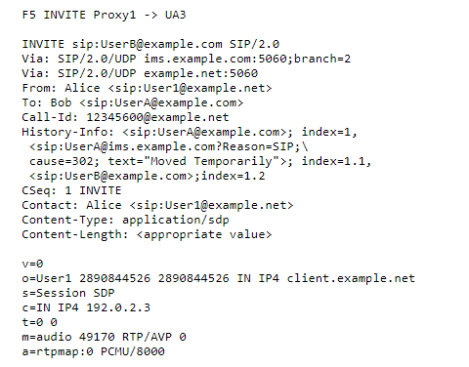
Sıp Detaıls and sdp detaıls for f5 ınvıte (rfc 4244)
SESSION INITIATION PROTOCOL (SIP)
History Info
Notes:
Should i replace RFC-4244? Because You said this example is wrong.
What shall i do right now ?

Slide 16
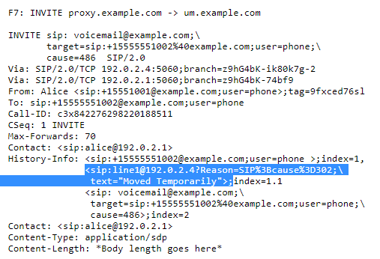
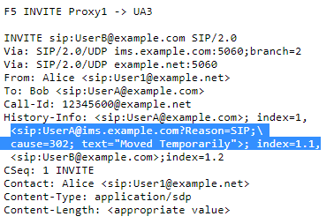
In this section we can see the spelling difference between RFC-4244 and RFC-4458. rfc -4244 rfc - 4458
SESSION INITIATION PROTOCOL (SIP)
History Info
Notes:
I’m not sure about these issues.I went from RFC-4244 to RFC-7044.They were different.I think in RFC-7044 information right.
For RFC-4458 I went from RFC-4458 to RFC-8119.but i didnt found anything for diffrence about syntax in RFC-8119
I putted screenshots on this part but we should to check again with together.

Slide 17
1.https://www.wikizeroo.org/index.php?q=aHR0cHM6Ly90ci53aWtpcGVkaWEub3JnL3dpa2kvU0lQ 2. https://www.3cx.com/pbx/sdp/ 3. https://www.tutorialspoint.com/session_initiation_protocol/ 4.https://www.dialogic.com/webhelp/IMG1010/10.5.3/WebHelp/sip_history_info_head.htm 5. https://andrewjprokop.wordpress.com/2014/12/29/a-look-at-how-avaya-aura-supports-sip-based-voice-mail/ 6. https://www.hjp.at/doc/rfc/ 7. https://tools.ietf.org/html/rfc4244#section-4.3.3.2 8. https://tools.ietf.org/html/rfc4458 9. https://tools.ietf.org/html/rfc3261#page-9 10. https://transnexus.com/whitepapers/sip-invite-header-fields/
SESSION INITIATION PROTOCOL (SIP)
Resources
Notes:
And last part for my questions.
May this part is stay?
Or may i remove on the there ?
i couldn't sure about that.
Is it necessary for last part?

